Slide 1


Slide 2

W
E
L
C
O
M
E

Slide 3

PRESENTATION
On…
I
N
N
E
R
C
I
T
Y
T
R
A
N
S
P
O
R
T
S
E
R
V
I
C
E
Online Ticketing

Slide 4

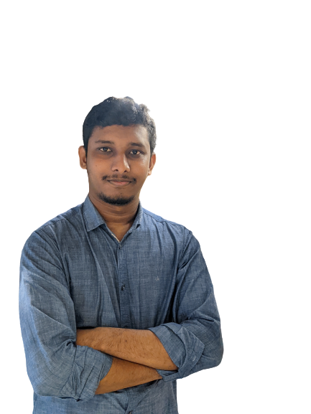


PRESENTED BY…
Farhan Israq
I’D: 19202103272
Intake: 44
Section: 07
Anupam Kumar
I’D: 19202103261
Intake: 44
Section: 07
Ebrahim Hossain
I’D: 19202103253
Intake: 44
Section: 07
Radia Binte Reza
I’D: 19202103246
Intake: 44
Section: 07
department of cse.

Slide 5
INTRODUCTION

Slide 6
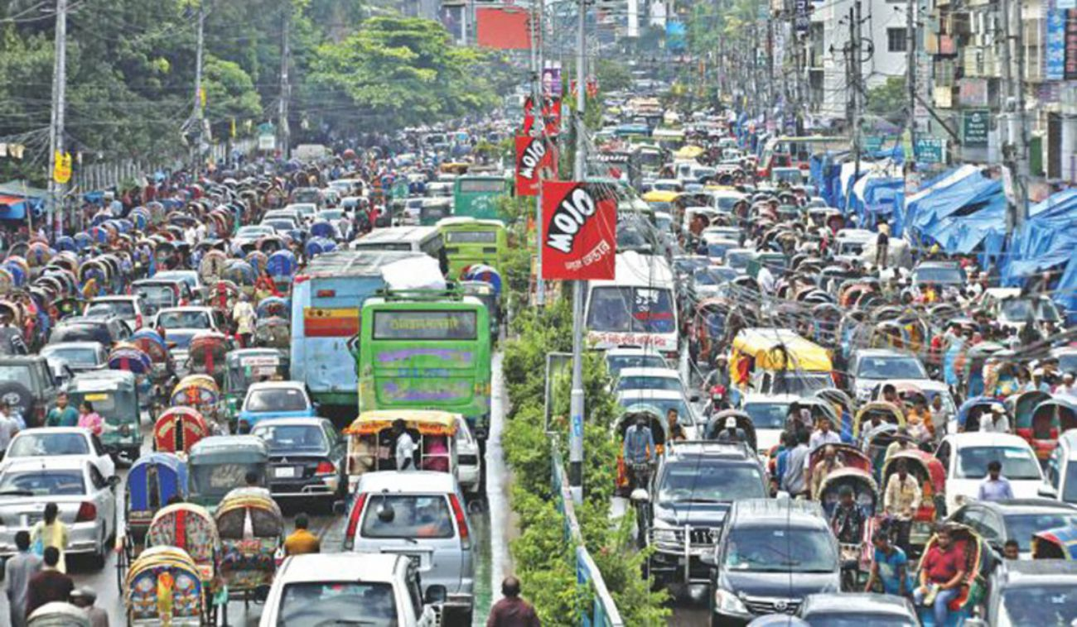
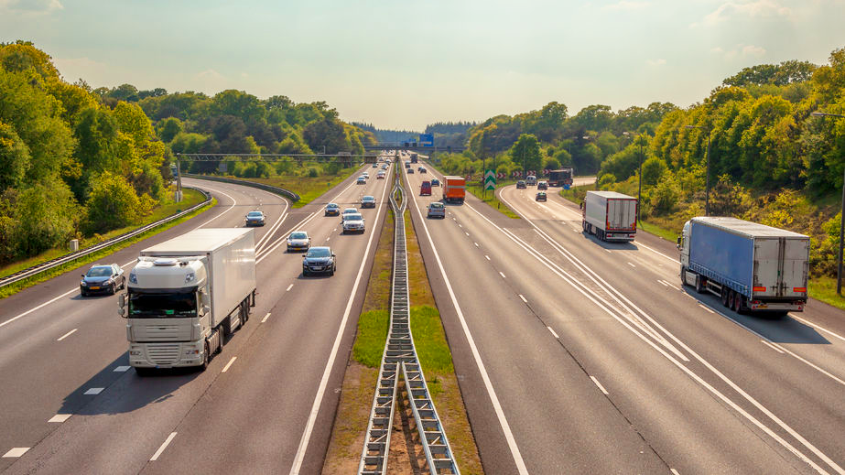
INTRODUCTION:
Inner city transport service is a project to hire all companies in a single company and run all buses sequentially in several routes. All bus tickets will be sold online. No bus can’t wait for passengers. All buses run at the correct time. No passenger can enter without a ticket. At this time the project is only for an online ticketing service. It helps to buy bus tickets easily. and the supervisor can check tickets easily. The admin can add update delete information to several tables.

Slide 7
OUR GOALS

Slide 8





GOALS & OBJECTIVE:
Reduce traffic jams.
Saving valuable time.
Reduce pollution.
Reduce road accidents.
Making the city sustainable.

Slide 9
FEATURES

Slide 10




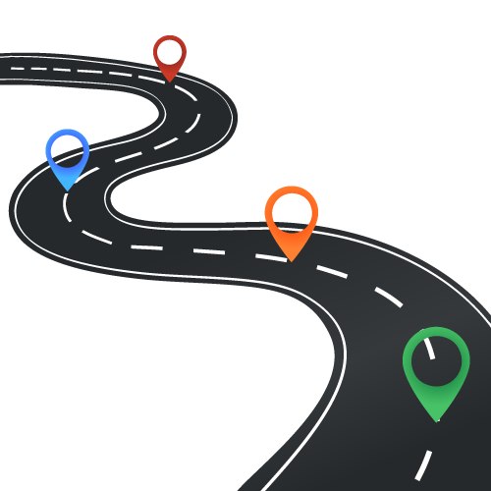

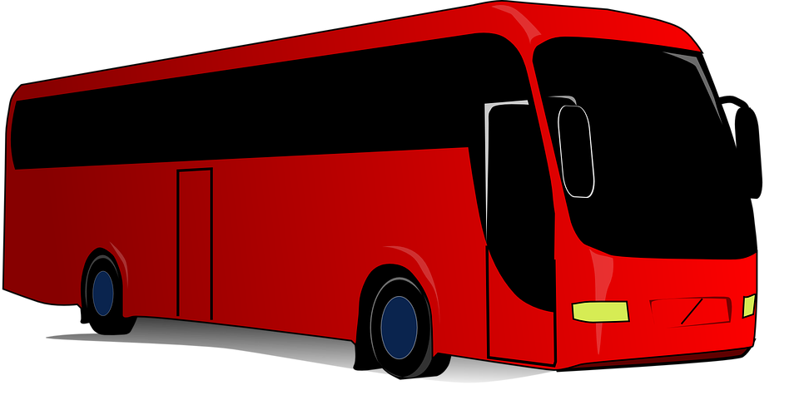
USER PANNEL:
01
USER LOGIN / REG.
At first, the user has to login to get the ticket.
03
PAYMENT
Now, come to the payment option. The user pay for his/her ticket.
02
ROUTE & TIME
Then, the user can select the route/destination and time.
04
TICKET
At last, the user get the ticket and he/she waiting for the Bus.

Slide 11


SUPERVISOR PANNEL:
LOGIN
CHECK TICKETS

Slide 12
ADMIN PANNEL:
UPDATE
ADD
DELETE
VIEW
ROUTE
BUS
SUPERVISOR
USER

Slide 13
SPECIFICATIONS

Slide 14

SOFTWARE SPECIFICATIONS:
HTML, CSS, JS editor : Visual Studio Code.
Graphics editor: Photoshop.
Web browsers: Google Chrome, Microsoft Edge.
Database: Xampp server, Google sheet.

Slide 15
FUTURE WORK

Slide 16
FUTURE WORK:
Inner to make inter transport service.
4
Others vehicle will add our system.
3
Automatic route update.
2
We will add QR-scanner.
1

Slide 17
CONCLUSION

Slide 18
CONCLUSION:
When the service will perfectly launch, the suffering of the people will
be reduced a lot. Because we first ensure that, the journey is safe and
sound. There is no hassle on our service.
We have a tag line-
Your safety is our first priority. Have a safe journey.

Slide 19

REFERENCE:
https://www.tutorialspoint.com/index.htm
https://www.w3schools.com/html/

Slide 20
THANK YOU…!!!
ANY QUESTION
?
?
.
?
.
.

